Slide 1

MACHINE INTELLIGENCE
Dr. N MEHALA
Department of Computer Science and Engineering

Slide 2

MACHINE INTELLIGENCE
Agenda
K-Means Clustering Algorithm : Example

Slide 3
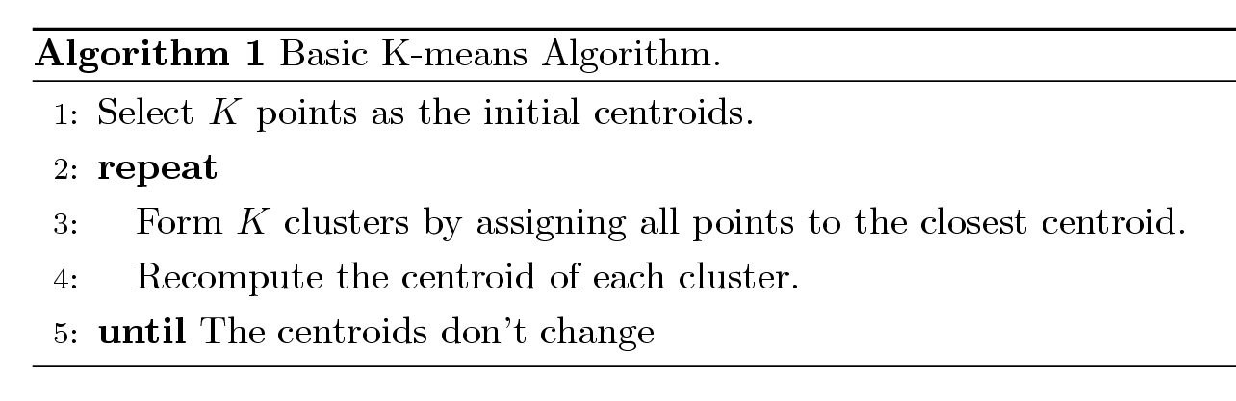
MACHINE INTELLIGENCE
K-Means Clustering Algorithm

Slide 4

MACHINE INTELLIGENCE
K-Means Clustering Algorithm : Applications

Slide 5
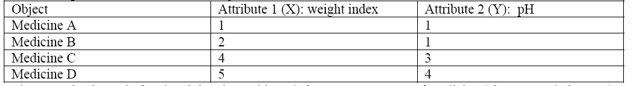
MACHINE INTELLIGENCE
K-Means Clustering: Example
Suppose we have 4 types of medicines and each medicine/object have two attributes or features as shown in the table. Our goal is to group these objects into K=2 group of medicine based on the two features (pH and weight index).

Slide 6
MACHINE INTELLIGENCE
K-Means Clustering: Example
Step1. Initial value of centroids: Suppose we use medicine A and medicine B as the initial centroids. Let c1 and c2 denote the coordinate of the centroids, then c1 = (1,1) and c2 = (2,1)

Slide 7
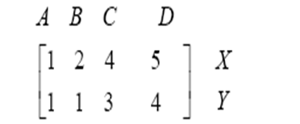
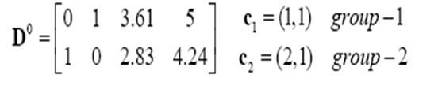


MACHINE INTELLIGENCE
K-Means Clustering: Example
Step2a. Objects-Centroids distance: we calculate the distance between cluster centroid to each object. Let us use Euclidean distance, then we have distance matrix at iteration 0 is
First row of the distance matrix corresponds to the distance of each object to the first centroid
Second row is the distance of each object to the second centroid
Distance from the MedicineC =(4,3) to the first centroid C₁=(1,1):
Distance from the MedicineC =(4,3) to second centroid C₂=(2,1):

Slide 8
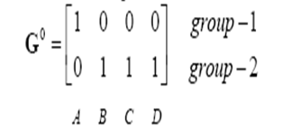
MACHINE INTELLIGENCE
K-Means Clustering: Example
Step2b. Objects clustering: we assign each object based on minimum distance. Thus medicineA is assigned to group1, medicineB is assigned to group2, medicineC is assigned to group2 and medicineD is assigned to group2. The element of Group matrix is 1 if and only if the object is assigned to that group.

Slide 9
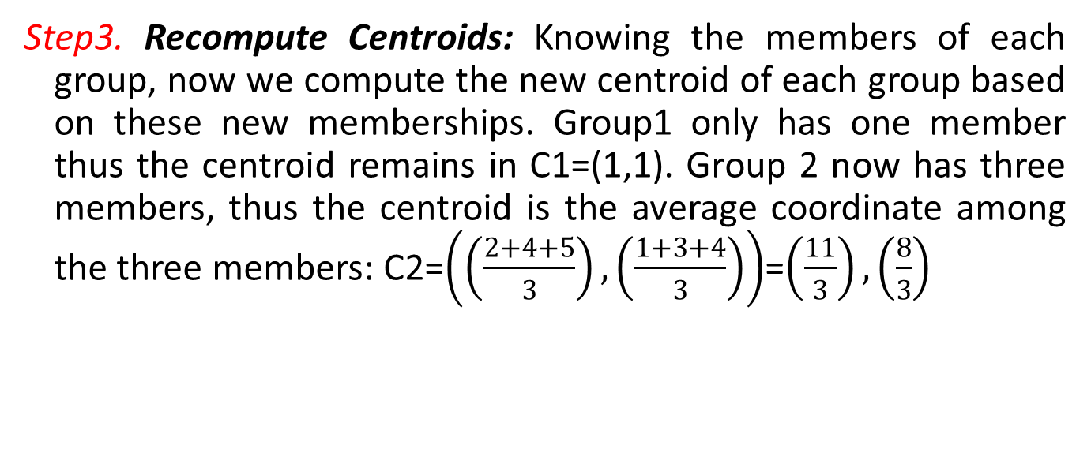
MACHINE INTELLIGENCE
K-Means Clustering: Example
Step3. Recompute Centroids: Knowing the members of each group, now we compute the new centroid of each group based on these new memberships. Group1 only has one member thus the centroid remains in C1=(1,1). Group 2 now has three members, thus the centroid is the average coordinate among the three members: C2=$\left(\left(\frac{2+4+5}{3}\right),\left(\frac{1+3+4}{3}\right)\right)$=$\left(\frac{11}{3}\right),\left(\frac{8}{3}\right)$

Slide 10
MACHINE INTELLIGENCE
K-Means Clustering: Example (Iteration1)

Slide 11



MACHINE INTELLIGENCE
K-Means Clustering: Example (Iteration1)
Step2a. Objects-Centroids distance
Step2b. Objects clustering
Step3. Recompute Centroids

Slide 12


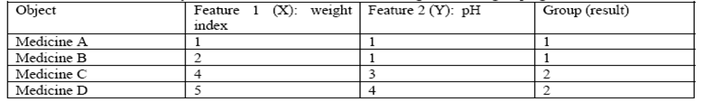
MACHINE INTELLIGENCE
K-Means Clustering: Example (Iteration2)
Step2a. Objects-Centroids distance
Step2b. Objects clustering

Slide 13
MACHINE INTELLIGENCE
K-Means Clustering: Evaluation
Most common measure is Sum of Squared Error (SSE)
For each point, the error is the distance to the nearest cluster
To get SSE, we square these errors and sum them.
x is a data point in cluster C_{i} and m_{i} is the representative point for cluster C_{i}
can show that m_{i} corresponds to the center (mean) of the cluster
Given two clusters, we can choose the one with the smallest error
One easy way to reduce SSE is to increase K, the number of clusters
A good clustering with smaller K can have a lower SSE than a poor clustering with higher K

Slide 14
MACHINE INTELLIGENCE
K-Means Clustering: Evaluation

Slide 15
MACHINE INTELLIGENCE
K-Means Clustering: Summary
Pros: Easy to implement
Cons: Can converge at local minima; slow on very large datasets
Works with: Numeric values

Slide 16
MACHINE INTELLIGENCE
K-Means Clustering: Summary
General approach to k-means clustering
Collect: Any method.
Prepare: Numeric values are needed for a distance calculation, and nominal values can be mapped into binary values for distance calculations.
Analyze: Any method.
Train: Doesn’t apply to unsupervised learning.
Test: Apply the clustering algorithm and inspect the results. Quantitative error measurements such as sum of squared error can be used.
Use: Anything you wish. Often, the clusters centers can be treated as representative data of the whole cluster to make decisions

Slide 17
MACHINE INTELLIGENCE
K-Means Clustering: Summary
Initial centroids are often chosen randomly
Clusters produced vary from one run to another
The centroid is (typically) the mean of the points in the cluster.
‘Closeness’ is measured by Euclidean distance, cosine similarity, correlation etc.
Most of the convergence happens in the first few iterations
Often the stopping condition is changed to ‘Until relatively few points change clusters’
Let, n = number of points, K = number of clusters, I = number of iterations, d = number of attributes
Complexity is O( n * K * I * d )

Slide 18
MACHINE INTELLIGENCE
K-Means Clustering: Summary
Basic k-means algorithm can yield empty clusters
Several strategies to fill in the empty cluster
Choose the point that contributes most to the total SSE
Choose a point from the cluster with the highest SSE
If there are several empty clusters, the above can be repeated several times.

Slide 19
MACHINE INTELLIGENCE
K-Means Clustering: Summary
In the basic K-means algorithm, centroids are updated after all points are assigned to a cluster
An alternative is to update the centroids after each assignment of a point to a cluster (incremental approach)
all clusters start with a single point.
Each assignment updates zero or two centroids
Never get an empty cluster
More expensive
Introduces an order dependency

Slide 20
MACHINE INTELLIGENCE
Conclusions
K-Means Clustering (Partitional Clustering)
Example: K-Means Clustering
K-Means Clustering: Evaluation

Slide 21
MACHINE INTELLIGENCE
Resources
http://www2.ift.ulaval.ca/~chaib/IFT-4102-7025/public_html/Fichiers/Machine_Learning_in_Action.pdf
http://wwwusers.cs.umn.edu/~kumar/dmbook/.
ftp://ftp.aw.com/cseng/authors/tan
http://web.ccsu.edu/datamining/resources.html

Slide 22
THANK YOU
Dr. N MEHALA
Department of Computer Science and Engineering
mehala@pes.edu

